Slide 1
Capstone Project-2
Seoul Bike Sharing Demand Prediction ML SUPERVISED REGRESSION
VAIBHAV JAIN NICKY GHAI

Slide 2
Contents
Problem Statement
Data Summary
Data Analysis
Analysis Details
Feature Selection
Data Preparation
Implementing Various Regression Algorithms
Challenges
Conclusions

Slide 3
Problem Statements
Prediction of bike count required at each hour.
Reduce waiting time of public.

Slide 4
Data Summary
Date : Year-Month-Day
Rented Bike Count - Count of bikes rented at each hour
Hour - Hour of the day
Temperature - Temperature in Celsius
Humidity - %
Windspeed - m/s
Visibility - 10m
Dew point temperature -Celsius
Solar radiation -MJ/m2
Rainfall -mm
Snowfall -cm
Seasons -Winter, Spring, Summer, Autumn
Holiday -Holiday/No Holiday
Functional Day - NoFunc(Non Functional Hrs),Fun(Functional Hrs)

Slide 5
Basic Data Exploration
The dataset has 8760 rows and 14 features(columns).
Three categorical features ‘Seasons’, ‘Holiday’, & ‘Functioning Day’.
One Datetime[ns] features ‘Date’.
Outliers present only in dependent variable.
No Missing Values.
No Duplicated values.
No null values.

Slide 6
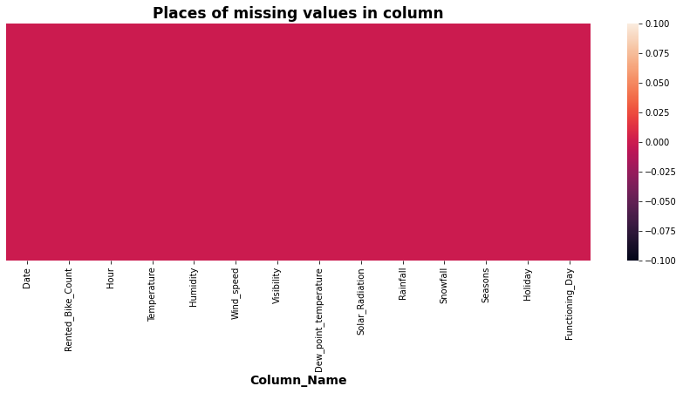
Missing Values

Slide 7
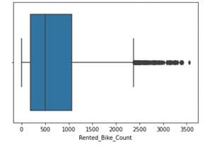
Checking for the outlier in our dependent variable

Slide 8
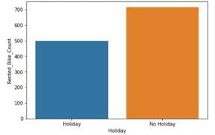
Division on rented bike on holiday and non holiday days

Slide 9
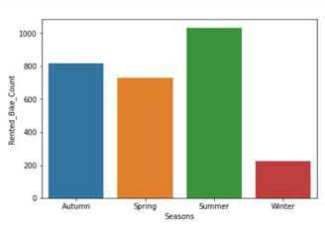
Distribution on rented bike according to different seasons

Slide 10
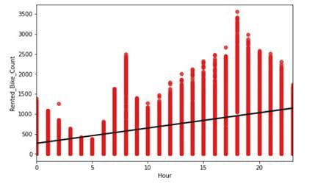
Chart showing distribution of Rented bike count per hour

Slide 11
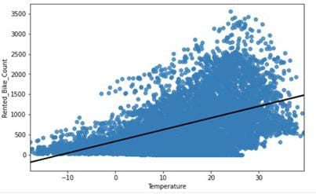
Relation of our dependent variable with Temperature

Slide 12
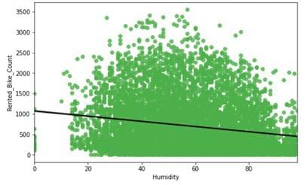
Relation of our dependent variable with Humidity

Slide 13
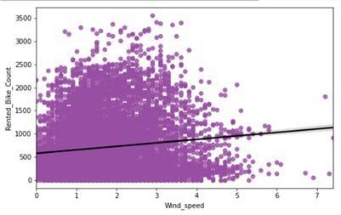
Relation of our dependent variable with wind speed

Slide 14
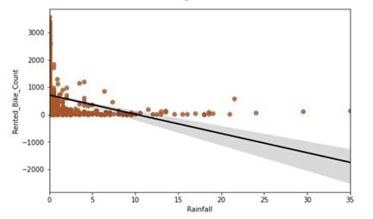
Relation of our dependent variable with Rainfall

Slide 15
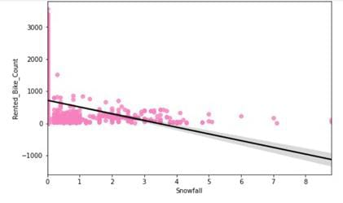
Relation of our dependent variable with Snowfall

Slide 16
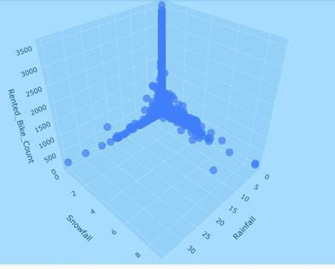
3-d plot showing relation between Snowfall , Rainfall and Rented bike count

Slide 17
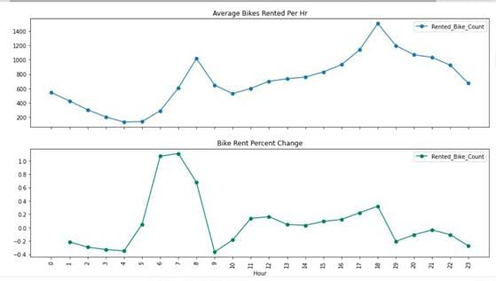
Per hour distribution

Slide 18
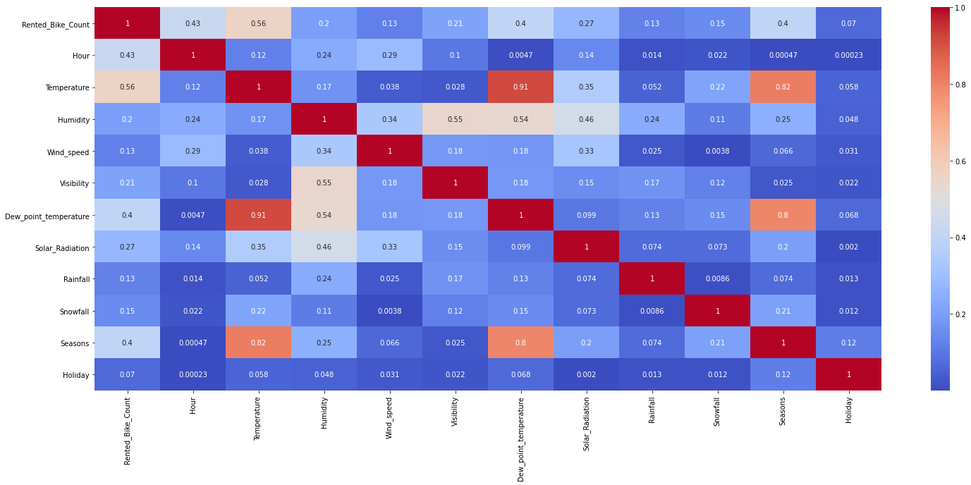
Correlation between different factors

Slide 19
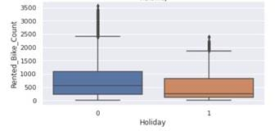
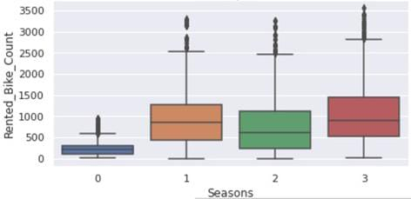
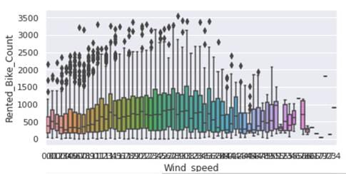
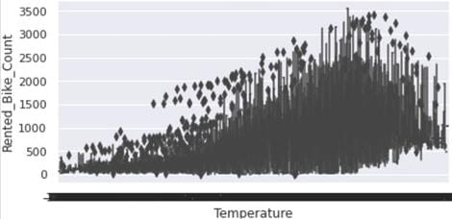
Outliers present in our important independent features

Slide 20
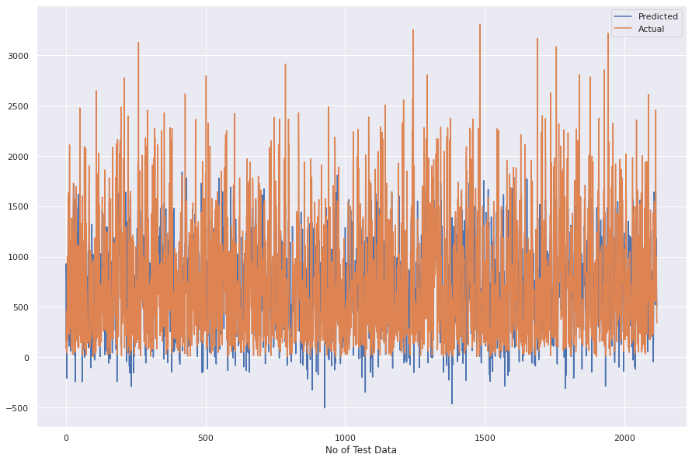
Linear Regression
MSE : 198793.5341180045
RMSE : 445.8626852720515
MAE : 333.68919457334323
r2_score
0.5073055437091121
Adjusted R2 : 0.5049660638596776

Slide 21
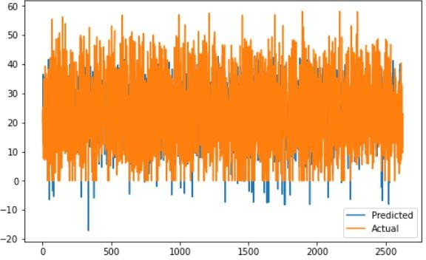
Lasso Regression
MSE : 198793.663747306
RMSE : 445.86283064111325
r2_score
0.5073052224328767
MAE : 333.68926336070683

Slide 22
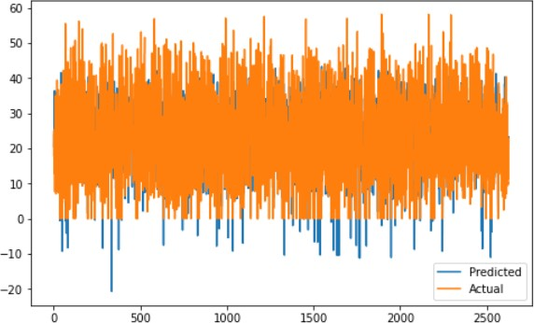
Ridge Regression
MSE : 198890.40226455292
RMSE : 445.97130206388044
r2_score
0.5070654634720594
MAE : 333.7678564764892

Slide 23
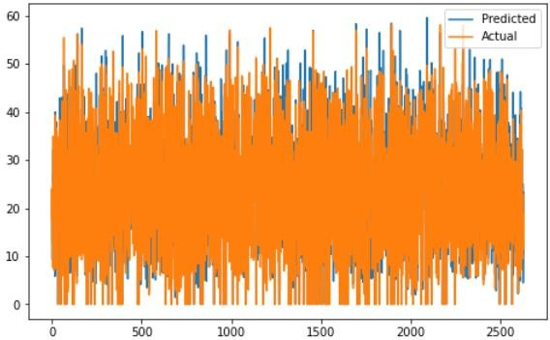
Decision Tree
MSE : 111943.4251299008
RMSE : 334.579475057722
r2_score
0.7225568466076131
Adjusted R2 : 0.7212394527168611
MAE : 193.50543221539914

Slide 24
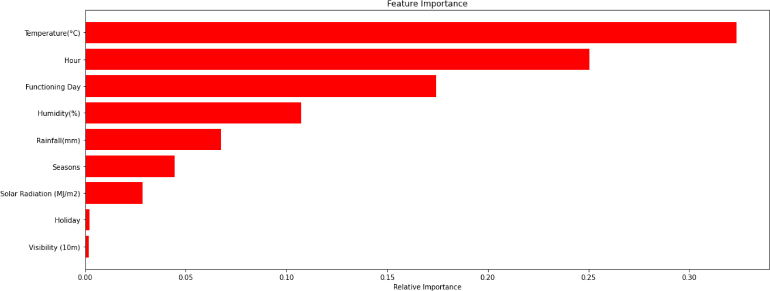
Gradient Boosting Machine
MAE : 174.081134728031
MSE : 67935.3191486026
RMSE : 260.6440468313109
Adjusted R2 : 0.830828056906927
r2_score
0.831627546241016

Slide 25
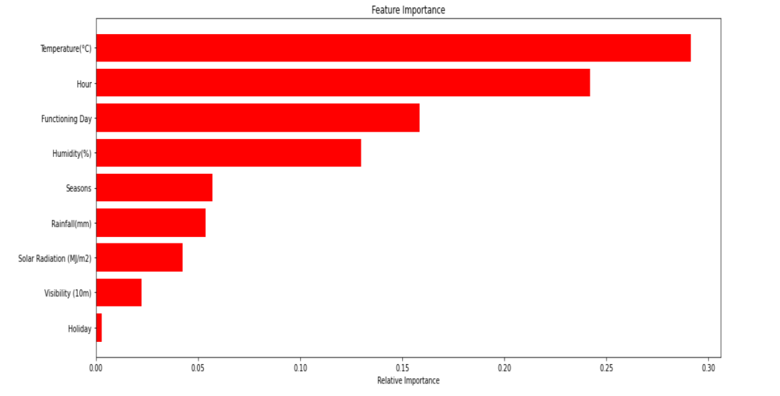
Random Forest
MSE : 60132.13303353803
RMSE : 245.21854137388965
MAE : 150.1287009919697
Feature Importance
Adjusted R2 : 0.8502594833570604
r2_score
0.8509671417532936

Slide 26
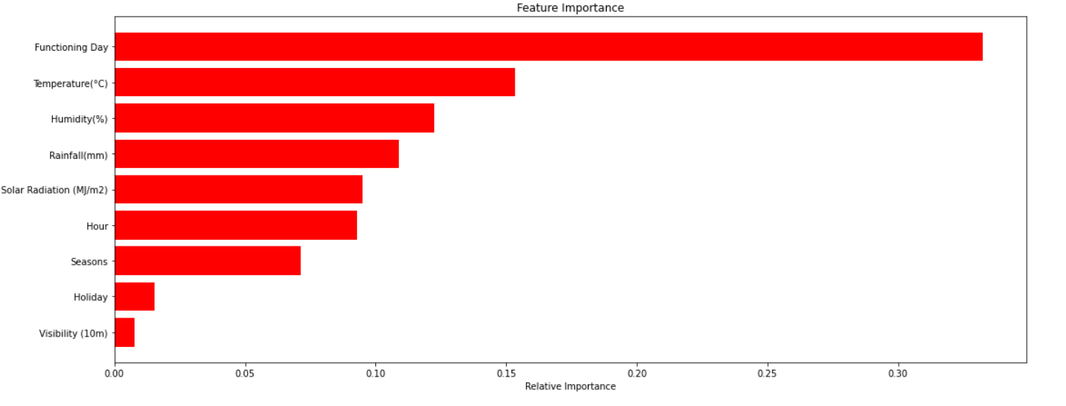
XGBoost
Feature Importance
MSE : 54287.031544213925
RMSE : 232.9957758076612
MAE : 143.48340080681663
adj_r2
0.8657453657658387
r2
0.8662260483087465

Slide 27
Challenges
Large Dataset to handle.
Outliers were also there in our independent features
Needs to plot lot of Graphs to analyse.
Carefully handled Feature selection part as it affects the R2 score.
Carefully tuned Hyperparameters as it affects the R2 score.

Slide 28
Conclusion
The Rented Bike Count has been increased from 2017 to 2018.
No overfitting is seen.
XGBoost Regressor gives the highest R2 score 95.27% .
Feature Importance value for Random Forest, Gradient Boost,
and XGBoost are different.
We can deploy this model.

Slide 29
THANK YOU

